Slide 1
Dof3aa
educational file management system

Slide 2
Team
- Mostafa Ahmed Hassan El-Gelany
- Mohamed Badawy Sayed
- Mahmoud Ahmed Khalil
- Ahmed Nageh Abbas

Slide 3





What Is The Problem ?
- There is no unified source for materials .

Slide 4
What Is The Main Problem ?
Blood Type: Essential for timely blood transfusions during emergencies.
Identification: Gathering the individual’s name, age and more… . Allergies: Inquiring about known allergies, particularly to common medications .
Medical History: Briefly documenting pre-existing medical conditions .
Crowded hospitals: The ambulance is transferred to the appropriate hospitals .
Emergency Contacts: Collecting contact information for family members .

Slide 5
Technologies Us
Blood Type: Essential for timely blood transfusions during emergencies.
Identification: Gathering the individual’s name, age and more… . Allergies: Inquiring about known allergies, particularly to common medications .
Medical History: Briefly documenting pre-existing medical conditions .
Crowded hospitals: The ambulance is transferred to the appropriate hospitals .
Emergency Contacts: Collecting contact information for family members .

Slide 7
Main Project Goals
1- Quickly locate the nearest hospital that has available places.
2- Reducing pressure on hospitals when accidents occur that involve a large number of injured people. 3- Surviving the largest number of injured people by distributing them to the nearest hospitals.
4- Rapid provision of blood types.
5- Updating the patient’s medical record so that any hospital or clinic can easily determine if the patient has chronic diseases or allergies and know the patient’s history and other information.

Slide 8
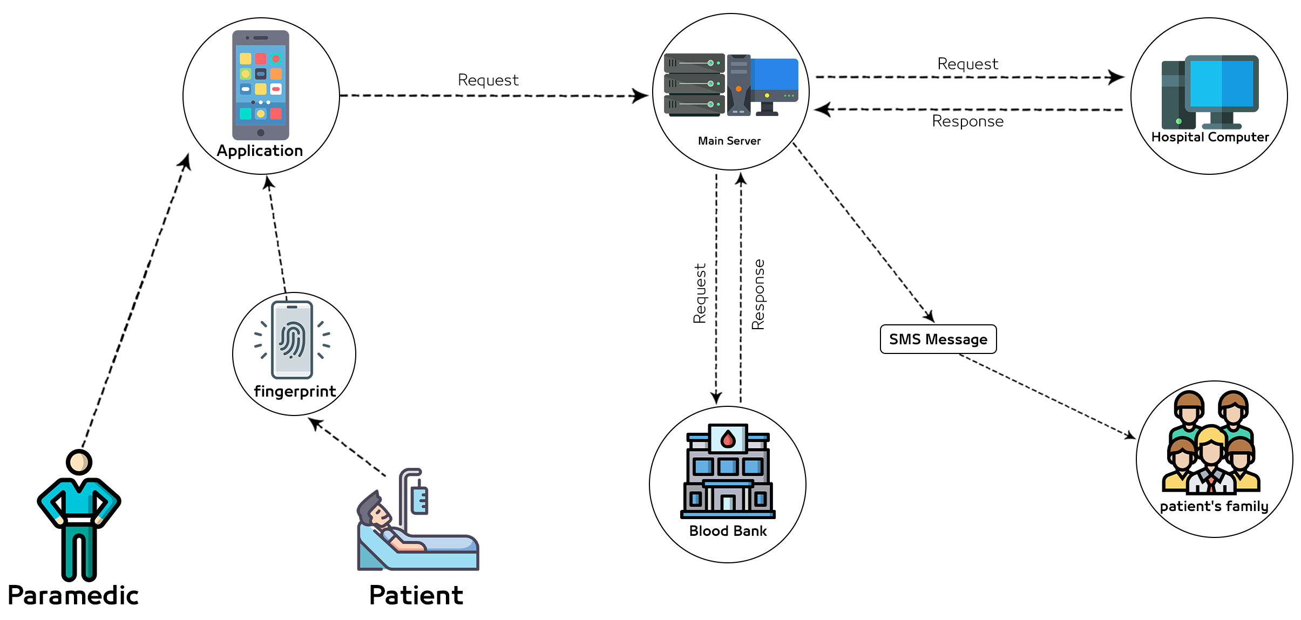
System Overview Diagram

Slide 9
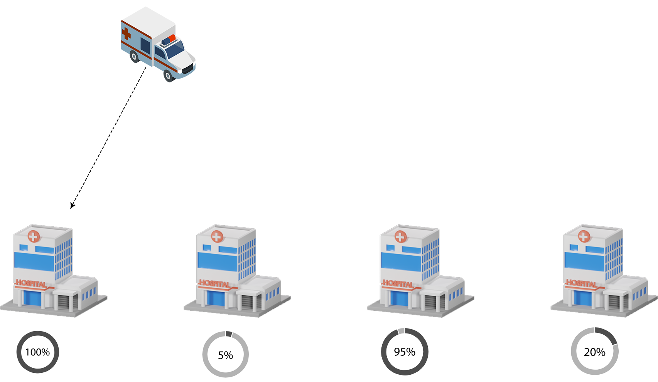
Choose the best hospital

Slide 10
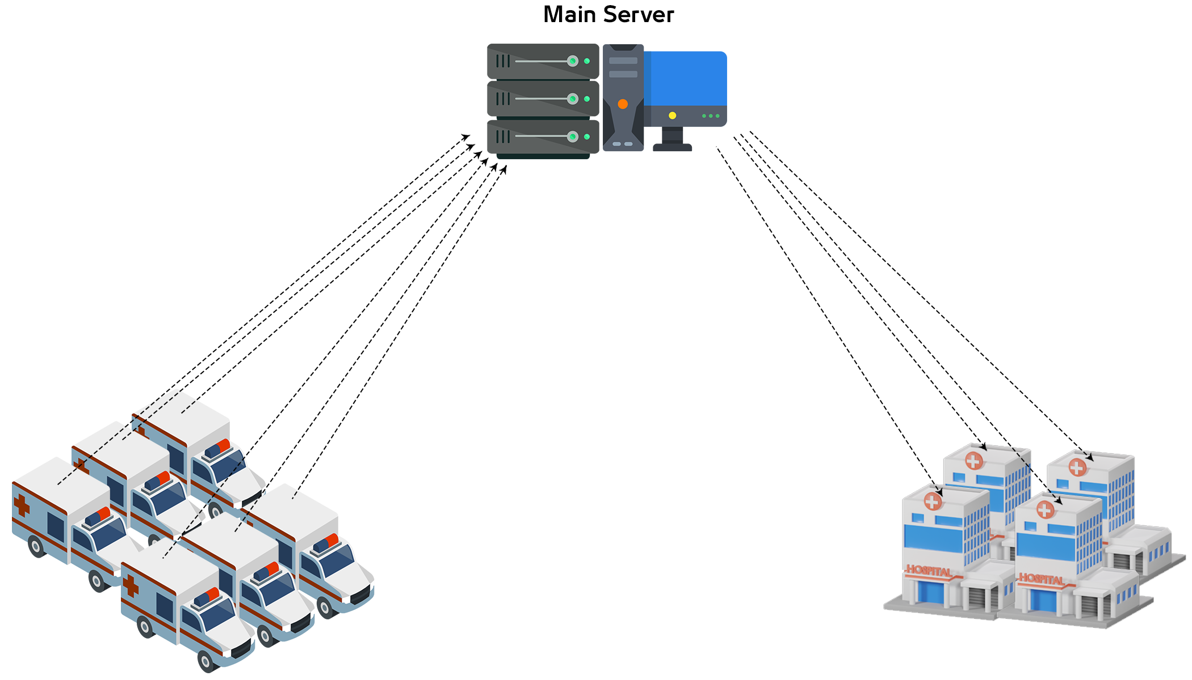
Choose the best hospital

Slide 11
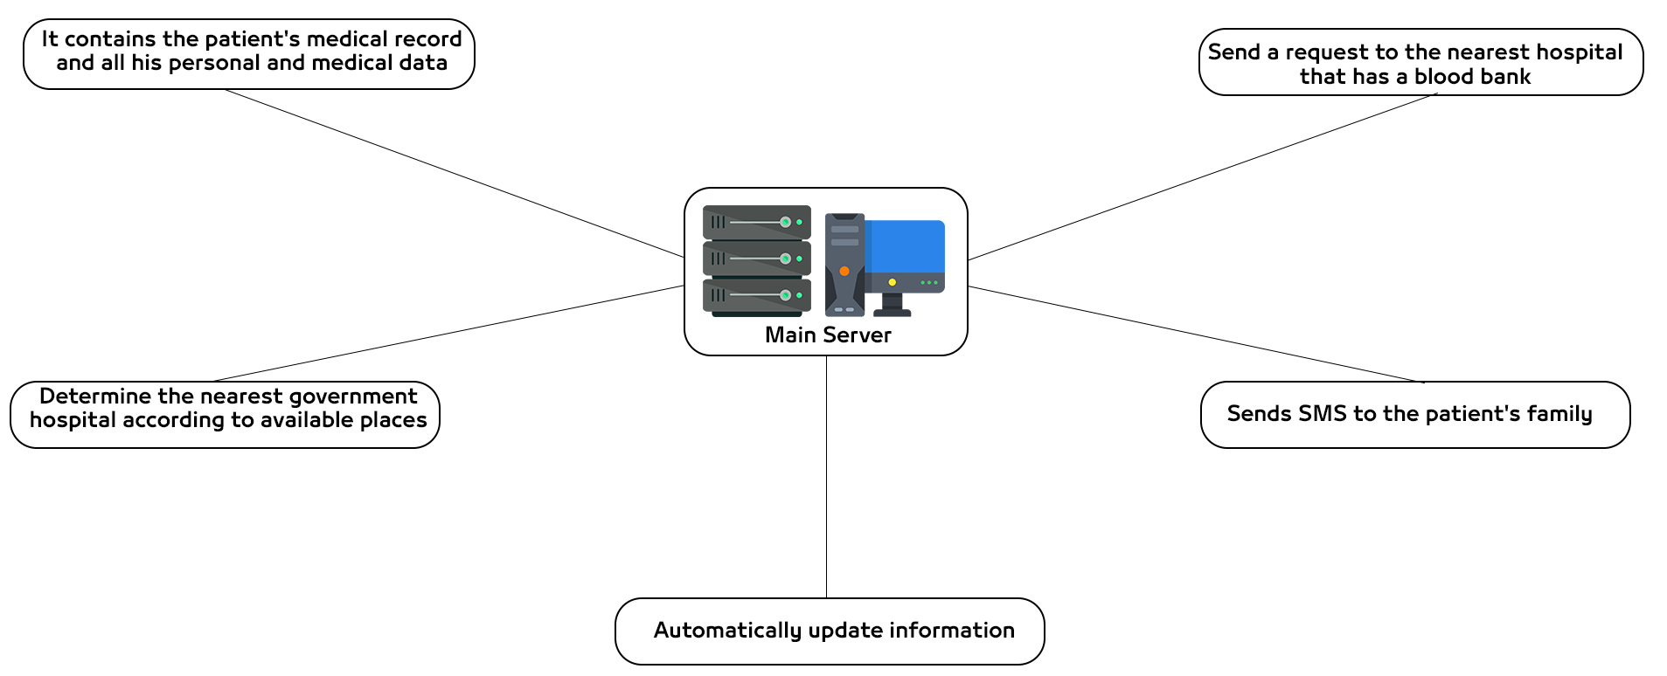
Choose the best hospital

Slide 12
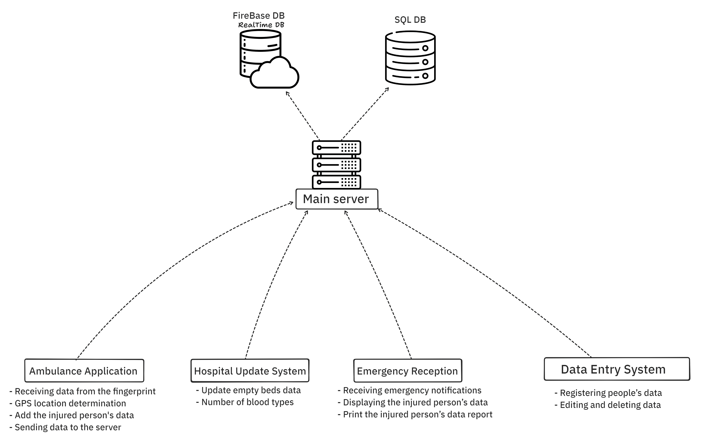
Choose the best hospital

Slide 13
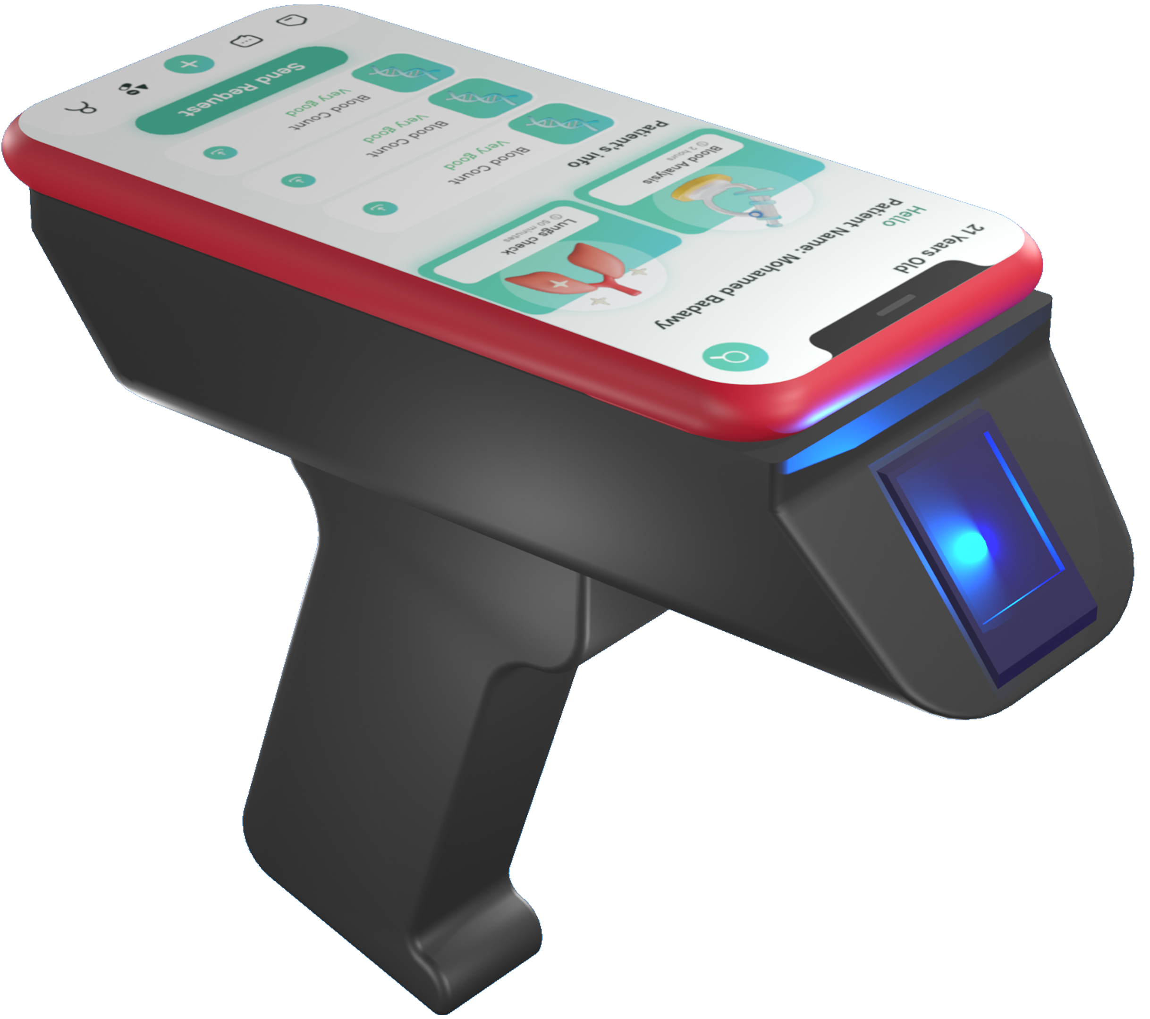
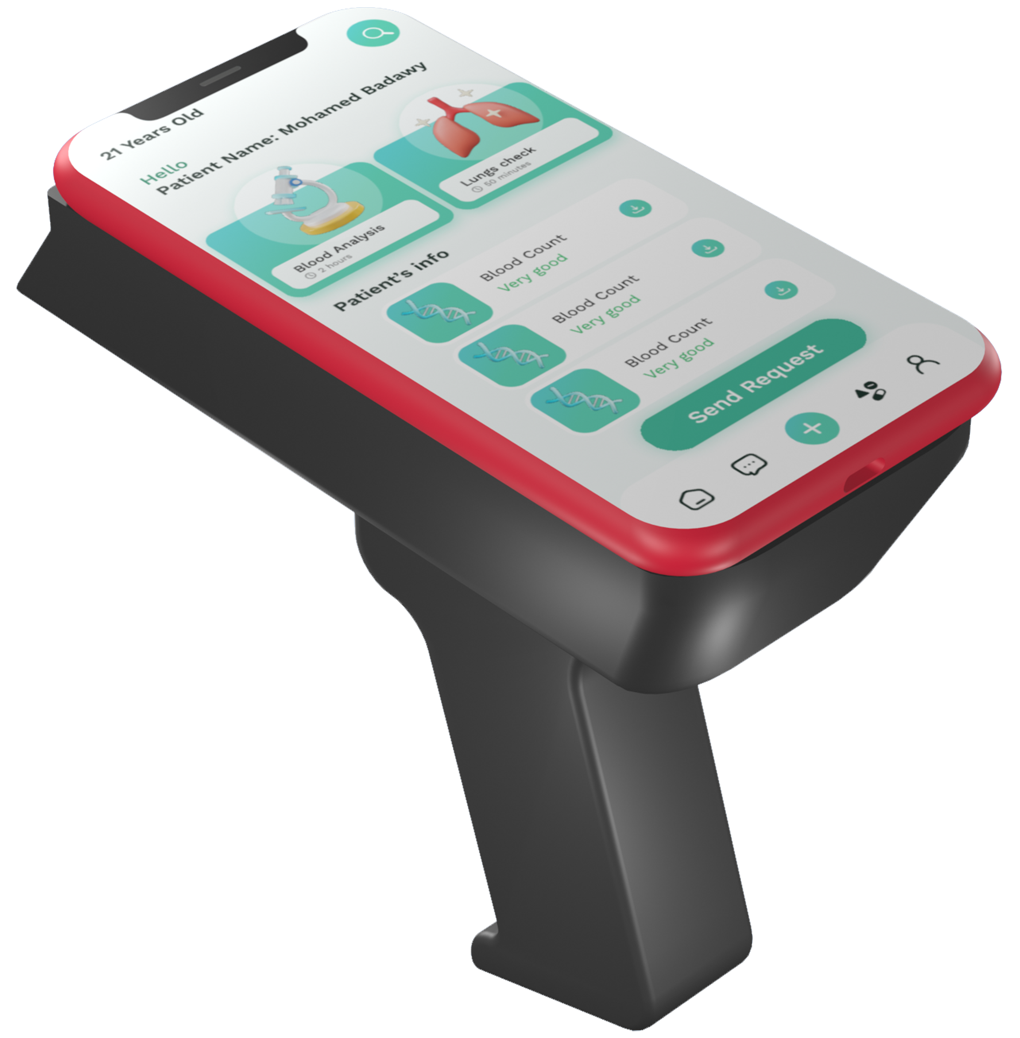
3D Model Prototype

Slide 14
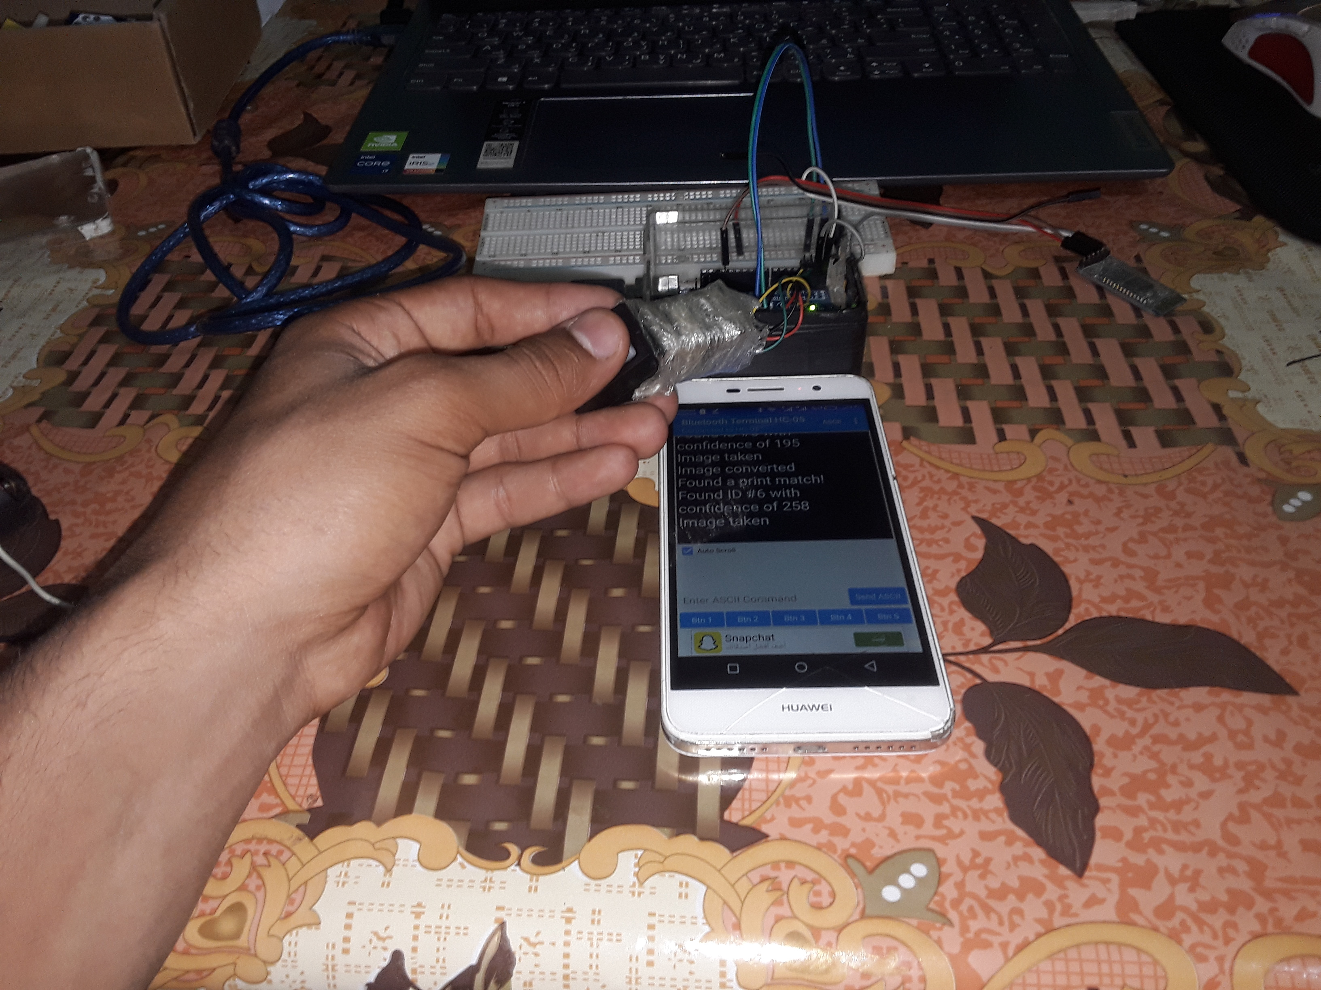
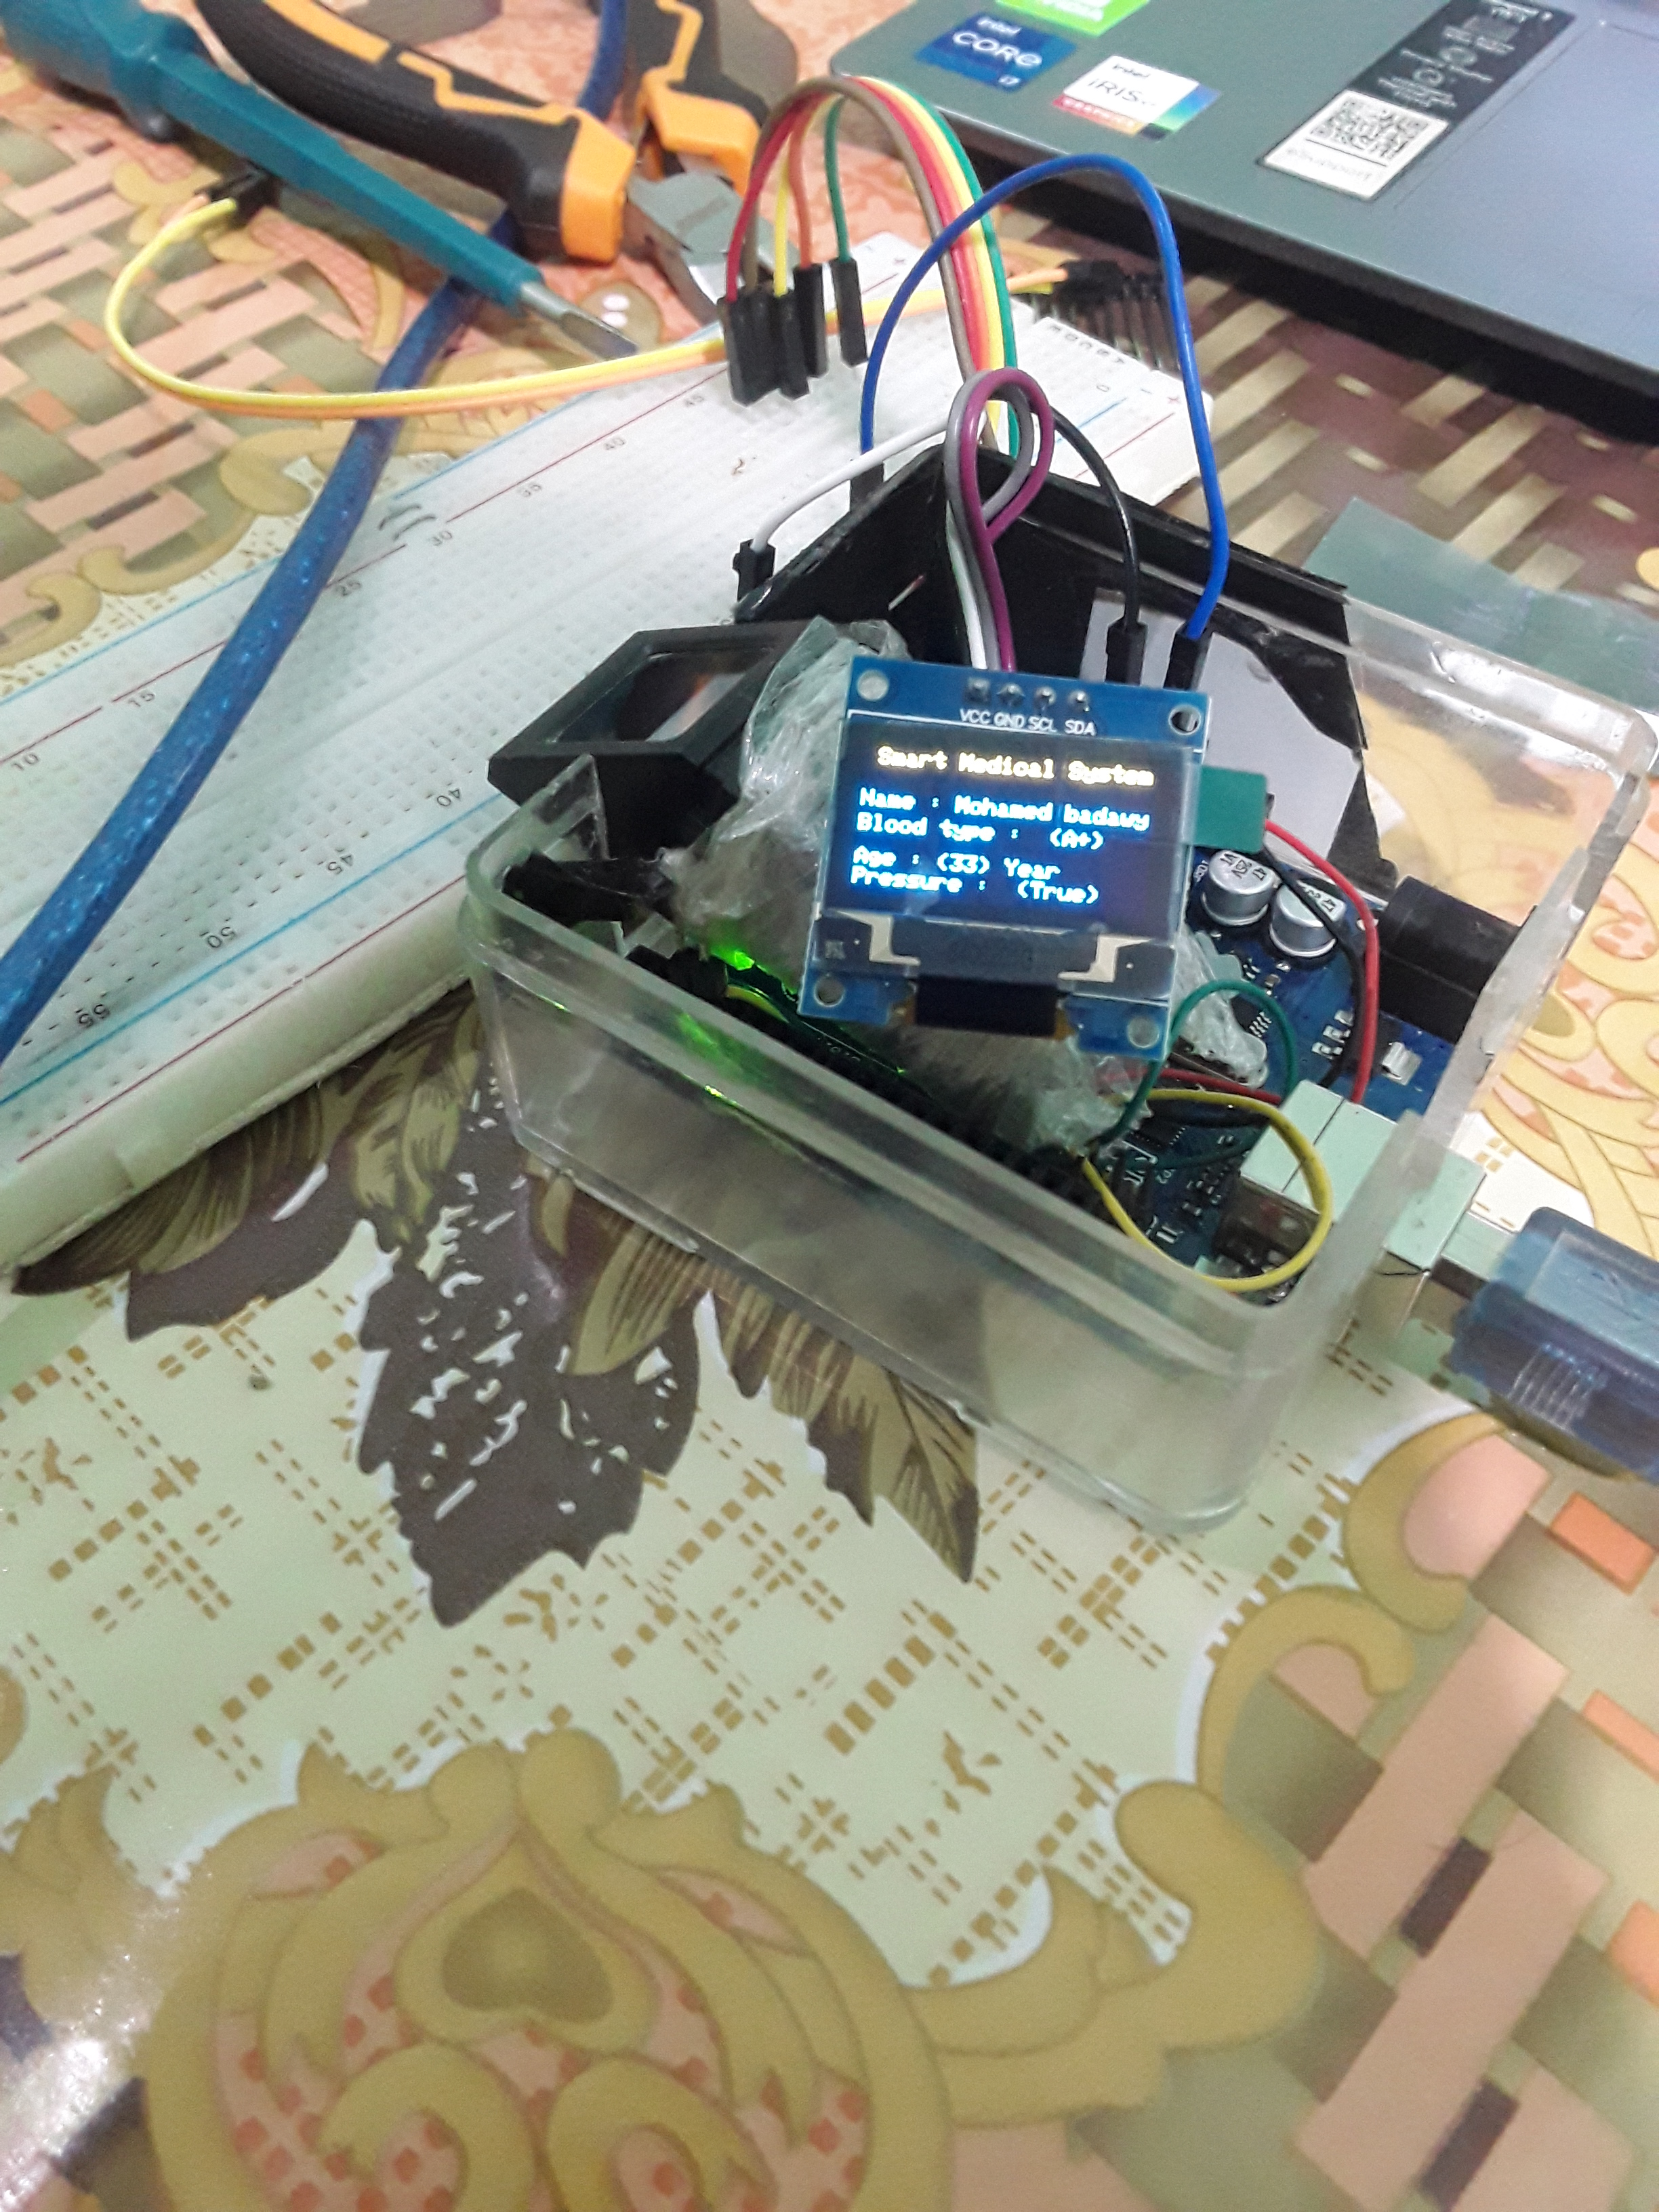
Prototype

Slide 15
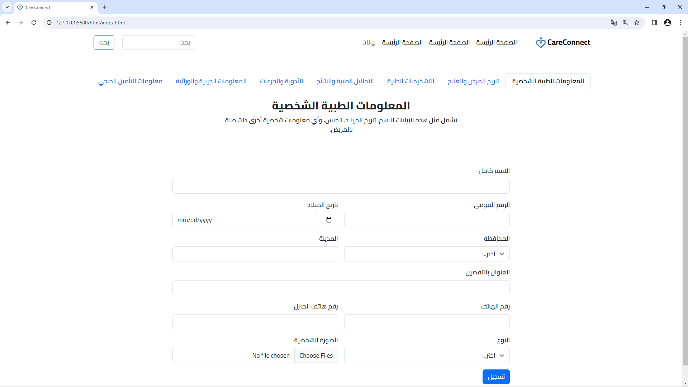
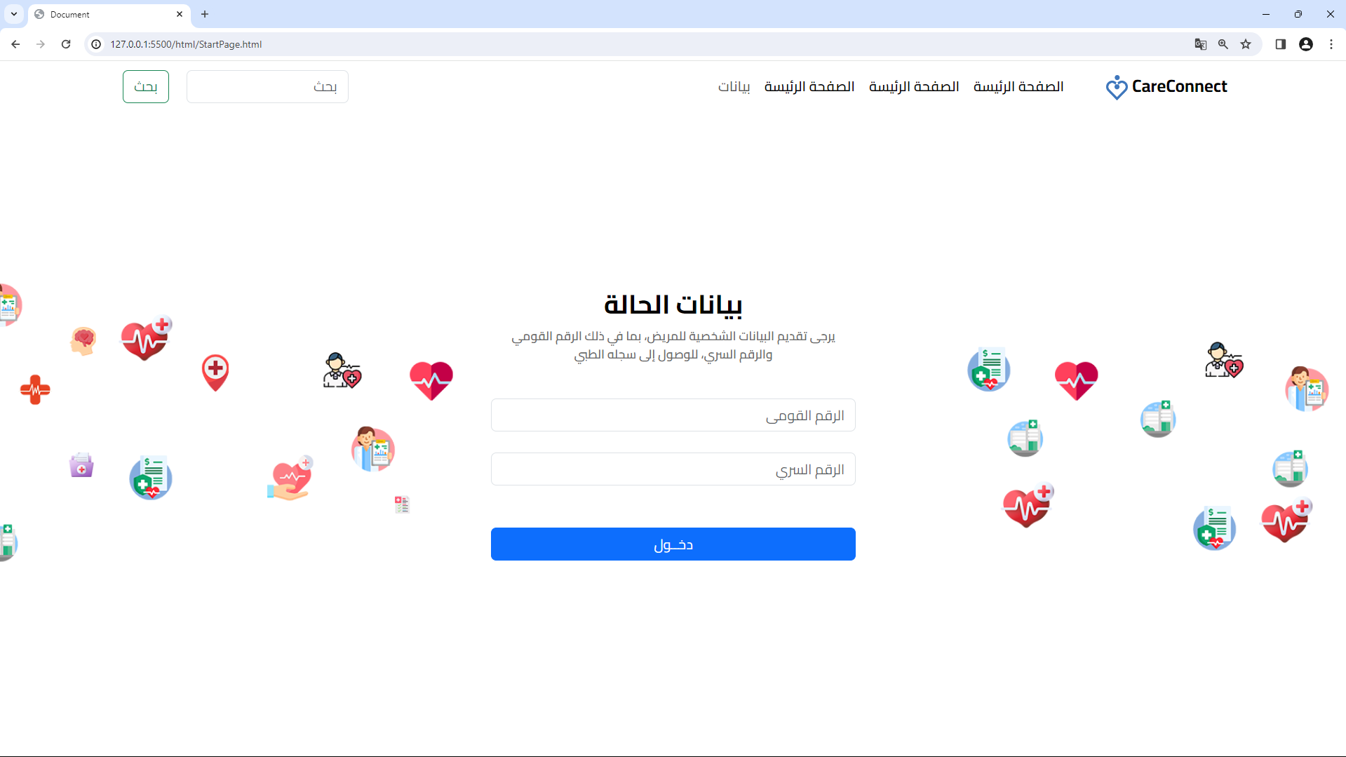
Doctors Website To Access Data

Slide 16
Doctors Website To Access Data

Slide 17
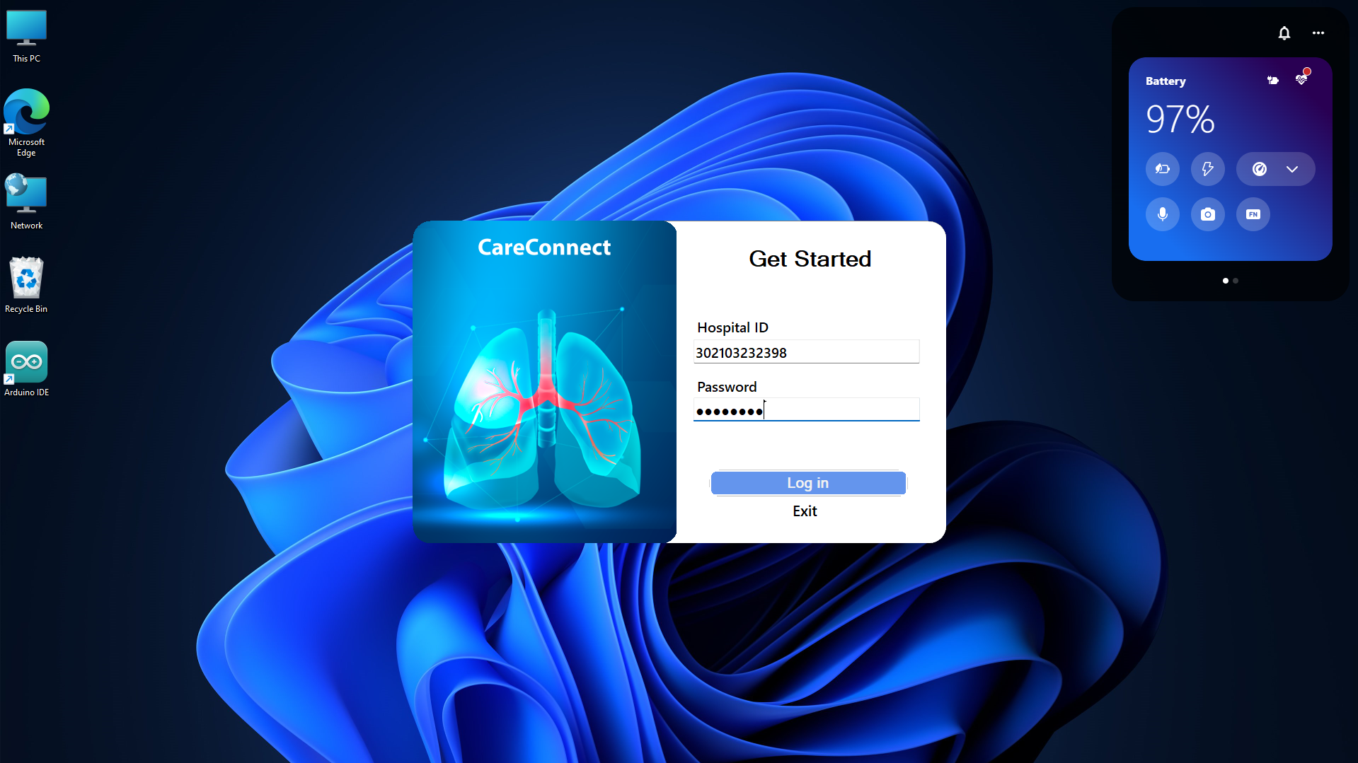
Hospital Desktop Management System

Slide 18
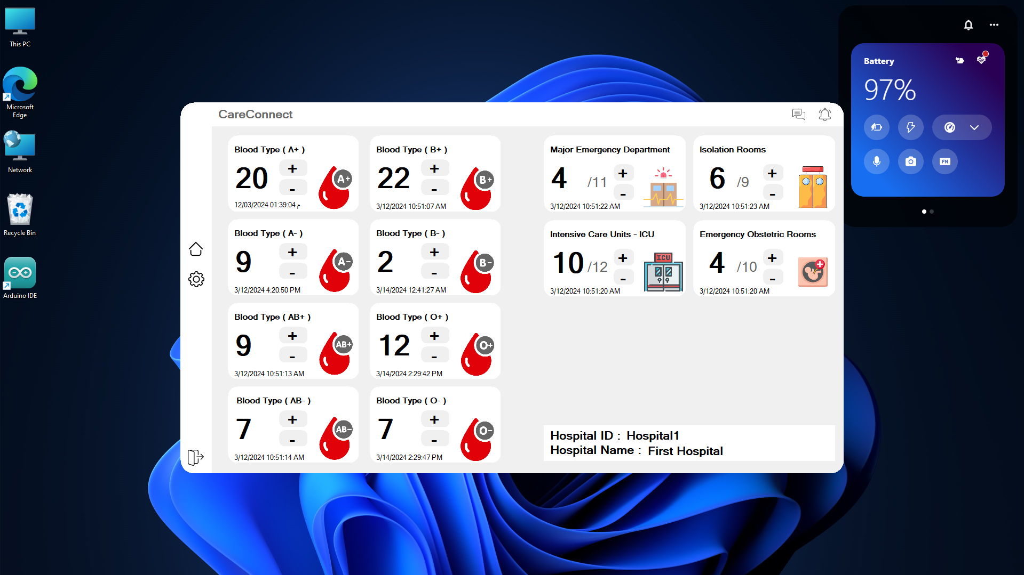
Hospital Desktop Management System

Slide 19
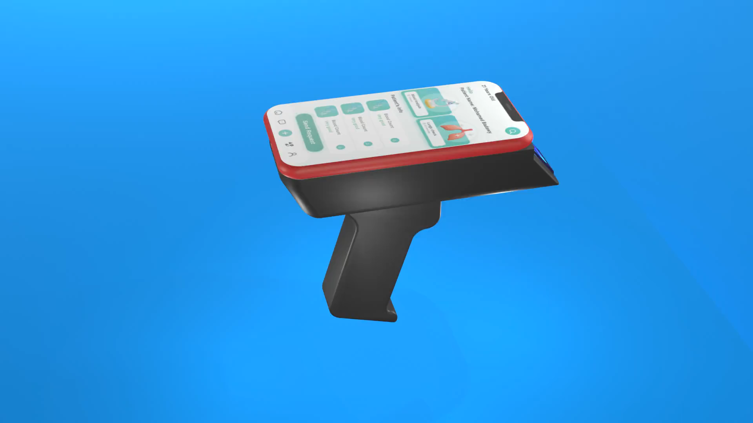

Slide 20
Thank You

